Slide 1


PERSONAL FINANCE MANAGEMENT SYSTEM
in partial fullfillment of CSF231 by group 10
PRANAY CHAKRAVARTY
ADITYA KHEMKA
AMAN DASH
RAGHAVAN TOSHNIWAL

Slide 2
Overview
A console-based Personal Finance Management System developed in Java that helps users track their income, expenses, and budgets efficiently. The system provides comprehensive financial tracking capabilities with features for managing multiple income sources, categorizing expenses, setting budgets, and generating reports.
Key Features
Income and expense tracking
Budget management
Financial reporting
Data visualization
Automated notifications
Data export capabilities

Slide 3
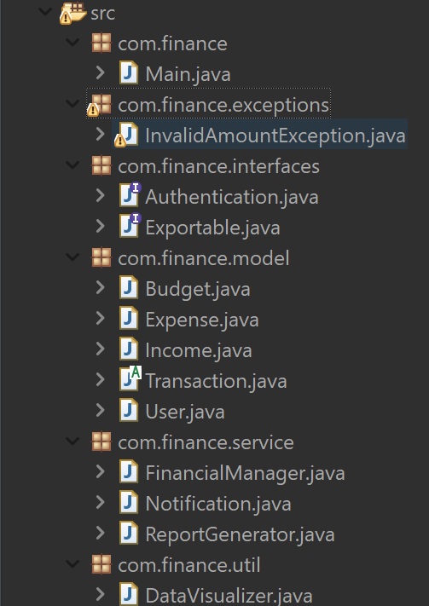

Technical Stack
OOP principles:
Encapsulation
Inheritance
Polymorphism
Abstraction
User input → Processing → Storage → Analysis → Output

Slide 4
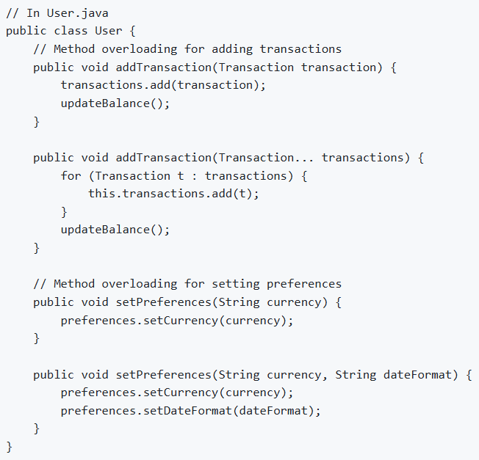
OOPS Features Implementation
1) Overloaded Methods:
Examples: User.addTransaction, FinancialManager.addTransaction, etc.
Implementation: Different parameter types
Benefits: Code reusability, flexibility
2) Overloaded Constructors:
Examples: Budget, User, Income, Expense
Implementation: Different parameter types
Benefits: Code reusability, flexibility
3) Vararg overloading:
Structure: Inner classes for specific functionality
Implementation: User & FinancialManager addTransaction(Transaction...)
Use cases: calculations
4) Nested Classes:
Structure: Inner classes for specific functionality
Implementation: Budget.BudgetCalculator
Use cases: calculations

Slide 5
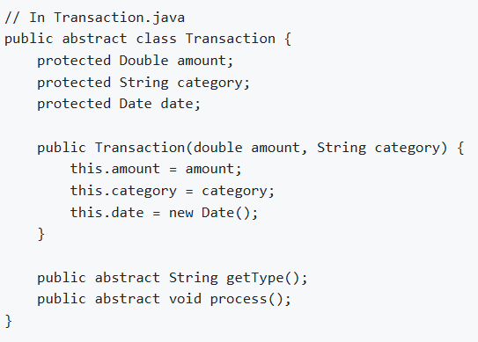
OOPS Features Implementation
5) Abstract Class:
Design: Base class for financial entities
Implementation: Transaction
Benefits: Code organization, inheritance
6) Interfaces:
Design: FinancialOperation, Reportable
Implementation: Exportable, Authentication
Multiple inheritance: Through interfaces
7,8) Inheritance:
Hierarchal: Income/Expense extends Transaction
Multiple: User/ReportGenerator implements interfaces
Benefits: Code reuse, polymorphism
9) Wrapper:
Implementation: Double in User, Transaction and Budget
Benefits: Code reuse, polymorphism

Slide 6
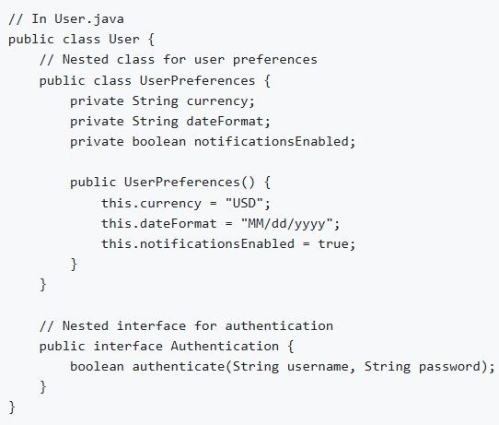
OOPS Features Implementation
10) Packages:
Implementation: com.finance.*
11) Exception Handling:
Custom exceptions:InvalidAmountException and Exception handling in File io.
Benefit: Graceful error handling
12) I/O Operations:
File handling: FinancialManager.saveData
User input: Validation and processing
13) Multithreading:
Implementation: Concurrent operations in Notification.java
Benefits: Improved performance

Slide 7
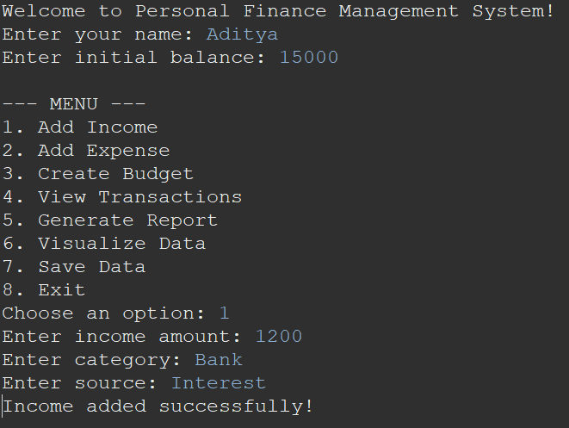
Usage
Managing Transactions
- Add Income:
* Enter amount, category, and source
* Example: Salary, Freelance work, Investments
- Add Expenses:
* Enter amount and category
* Example: Groceries, Rent, Utilities
- View Transactions:
* See all your income and expenses
* View transaction history- Add Income:
* Enter amount, category, and source
* Example: Salary, Freelance work, Investments

Slide 8
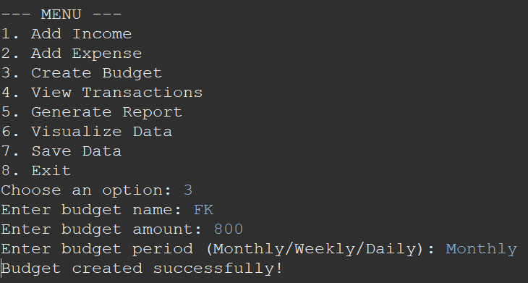
Usage
Budget Management
- Create Budgets:
* Set budget name and amount
* Choose period (Monthly, Weekly, Daily)
* Assign categories to budgets
- Monitor Budgets:
* View budget progress
* Receive notifications when approaching limits
* Get alerts for overspending

Slide 9
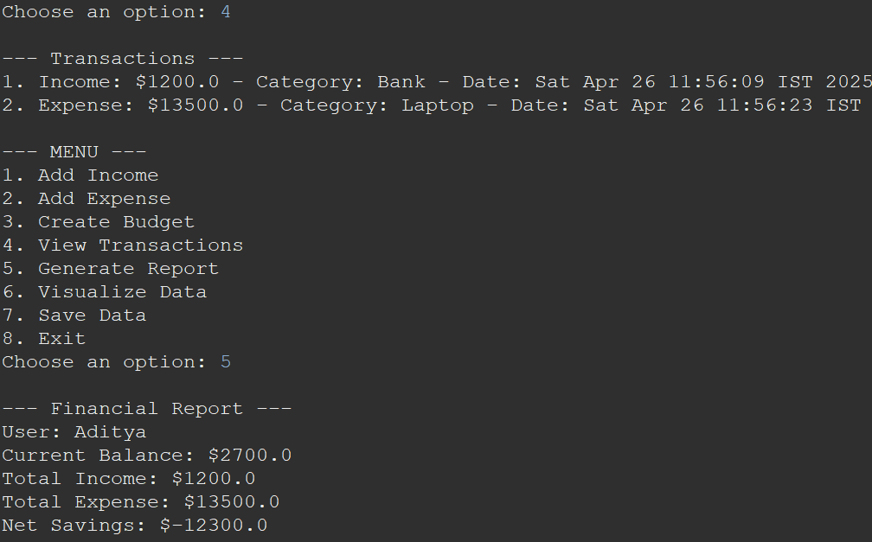
Usage
Reports and Analytics
- Generate Reports:
* Income vs Expenses
* Category-wise spending
* Monthly/Weekly summaries
- Export Data:
* Save reports to files
* Export transaction history
Notifications
Receive alerts for Budget limits approaching

Slide 10
Thank You

